Slide 1
Scribble – looks not bad to me
Method 1: as what polygon is from, create a line by Douglas-Peucker algorithm
Method 2: start from a polygon with 6 – 8 edges; triangulation polygon; connect triangles
Method 3: random

Slide 2
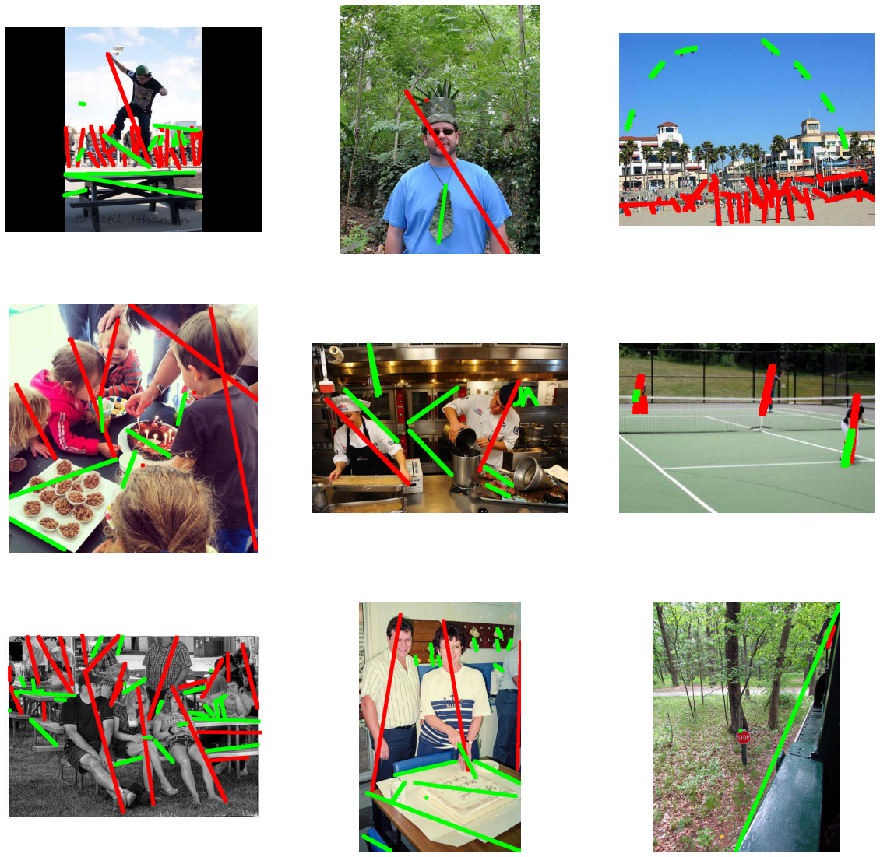
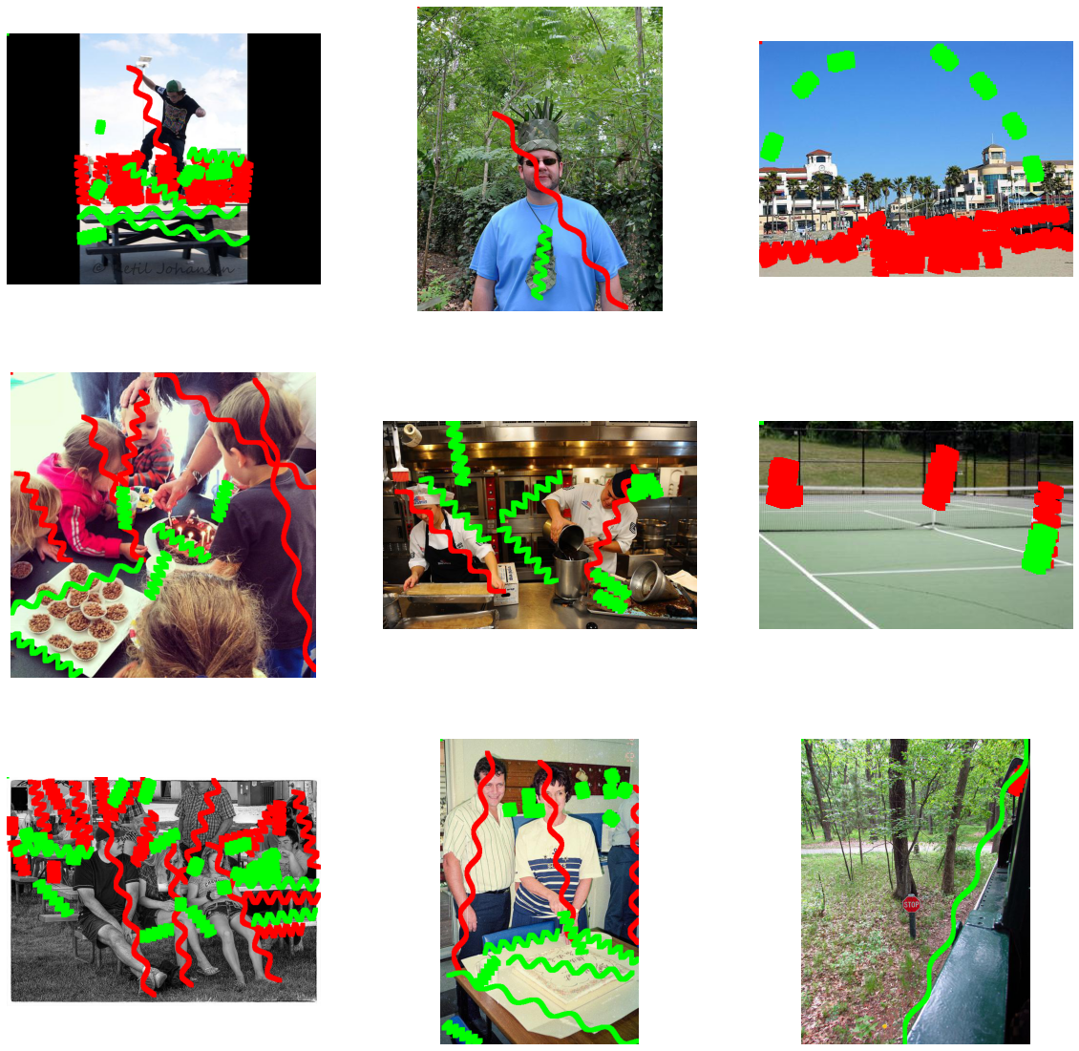
Method 1: as what polygon is from, create a line by Douglas-Peucker algorithm (red for target)

Slide 3
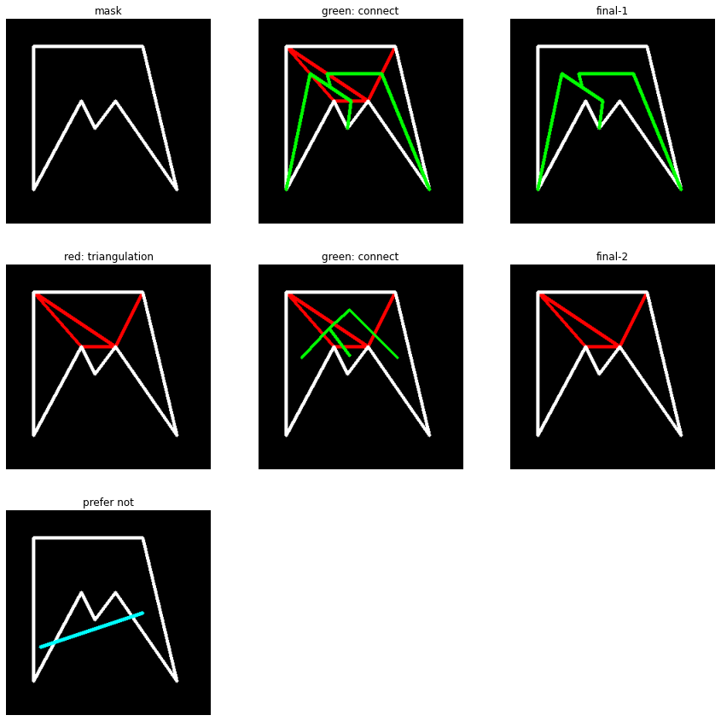
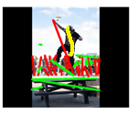
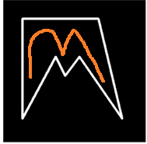
Method 2: start from a polygon with 6 – 8 edges; triangulation polygon; connect triangles

Slide 4
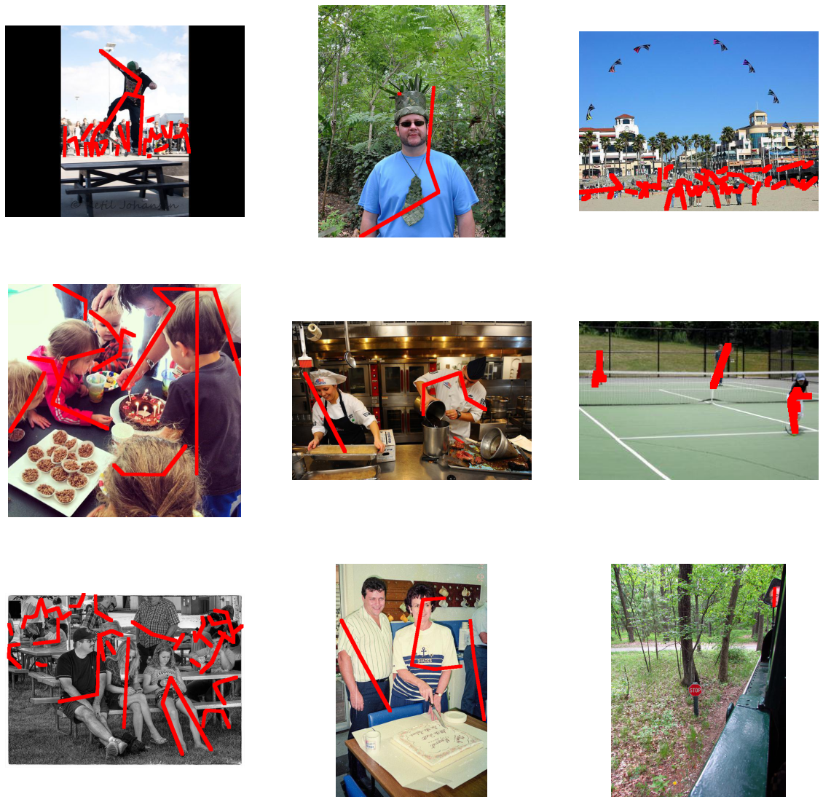


Slide 5
Method 3: random walk
Basic applied rules:
Try to turn when left and right distances to boundary varies a lot
Turn when no space ahead
Start at a side triangle towards mass center
Restart when scribble length is smaller than 0.1% of total mask size (draw too much in some cases, but without this rule, sometimes it will stuck at corner)
Abandoned rules
Try to turn when distance in current direction is long
Occasionally change direction to ‘towards mass center’ if possible
Start at random point with random direction
Add more weight to drawn scribble, like distance to drawn curve is 1/5 of real distance (to avoid curve to spiral inwards)

Slide 6
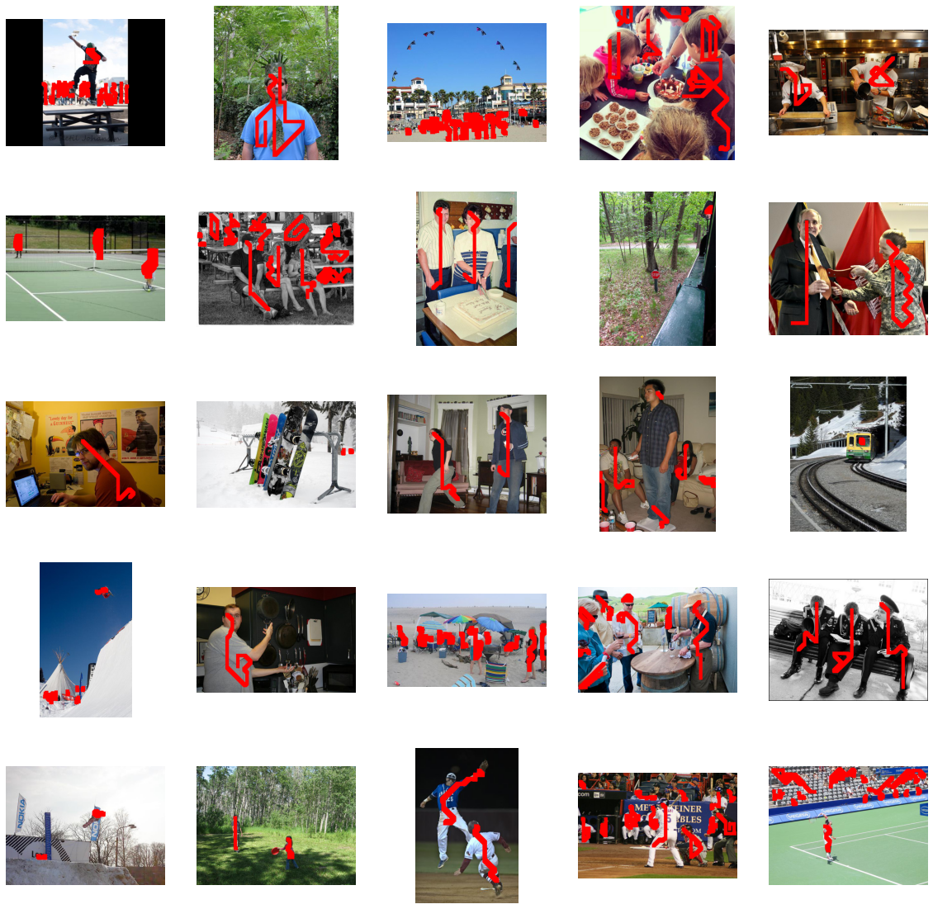
Best now

Slide 7
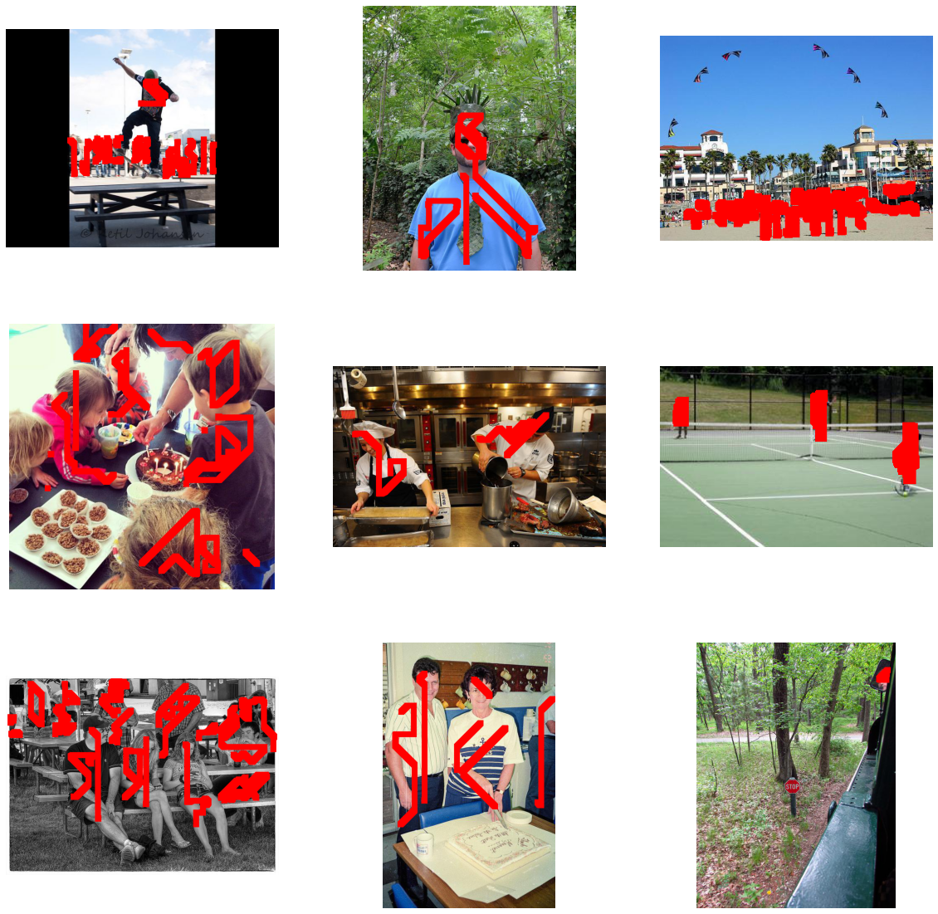
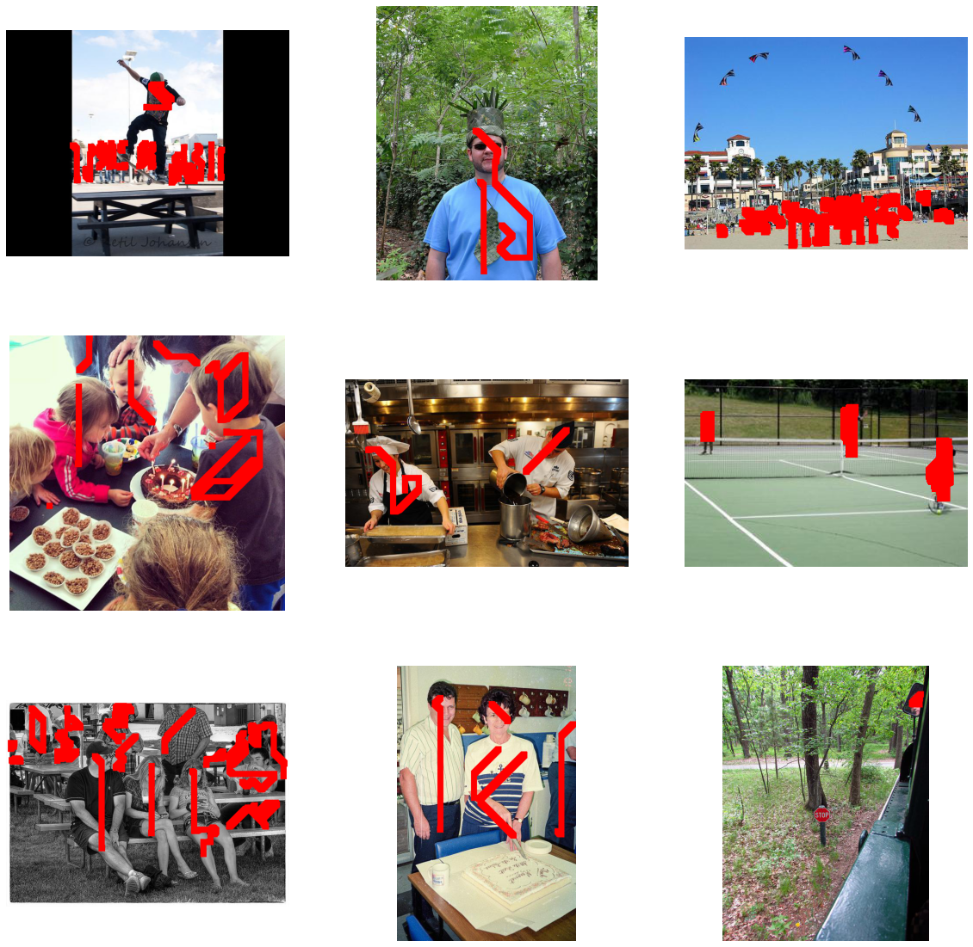
Some other decent ones

Slide 8
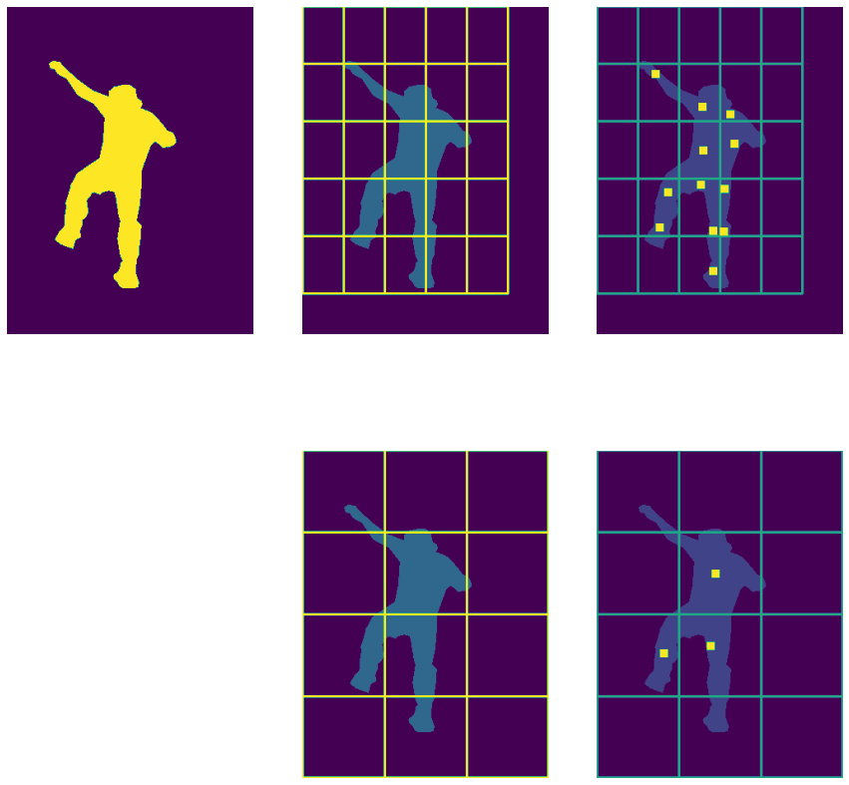
Cut bounding box into several small rectangles (like 3*4 = 12 rectangles)
Calculate pixel number with label 1 (target), ignore box if number is smaller than a threshold (like 20% of pixels)
Get density center for each small box, and connect them together
Problem: unknown order

Slide 9
I stop here for scribbles, and try to apply other imperfect annotation onto different objects: car, road, bridge, river
Category | Dataset Size (train/valid) | Valid IoU for different annotation type
 |  | Perfect mask | box | Filter (kernel size 3, 11, 21) | Polygon (3, 6, 10)
person | 8k (64k in all) / 2.7k | 0.558 | 0.396 | 0.559/0.469/0.367 | 0.348/0.467/0.535
road | 12k/500 | 0.557 | 0.402 | 0.549/0.523/0.402 | 0.312/0.455/0.551
 | 8k/ 3k | 0.545 | 0.412 | 0.531/ / | /0.425/
car | 15k/700 | 0.367 | 0.391
bridge | 1.6k/200 | 0.399
river | 2.3k/100 | 0.445 | 0.204 |  | x
River+sea | 8.9k/600 | 0.551

Slide 10
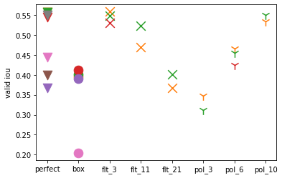
Marker type for annotation type
Color for object category
Orange for person
Green and red for road
Purple for car
Pink for river
Brown for bridge
Gray for river+sea
Sorry for this terrible plot, trying to find
a way to draw these together
Problem: whether it’s reasonable to put several categories together?
Like: water(river+sea), vehicle(car+truck+train)

Slide 11
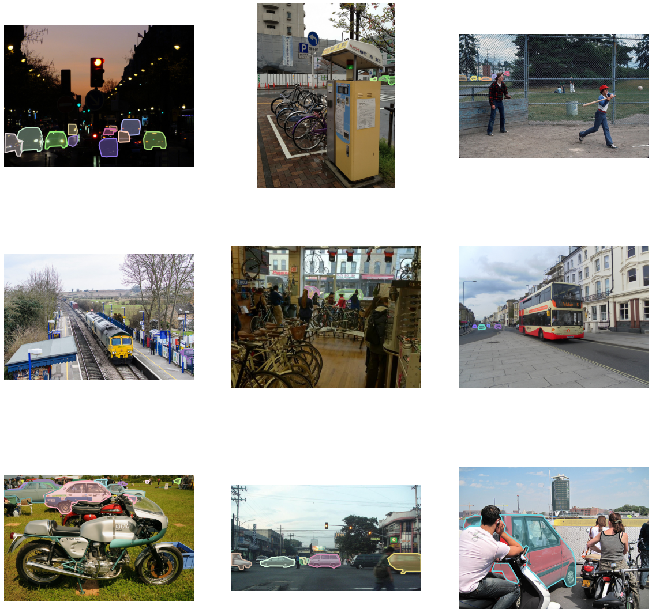
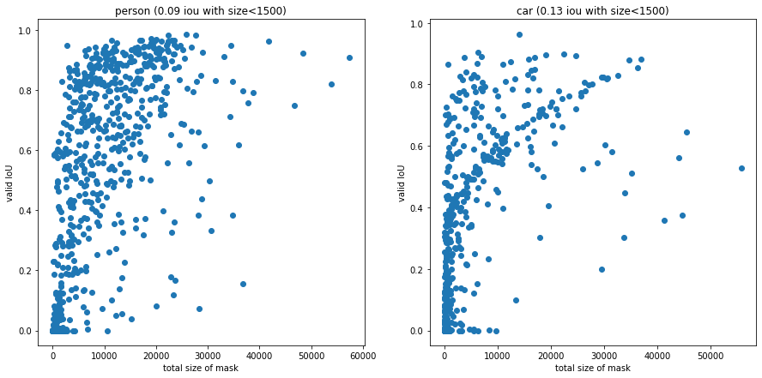
Category | Size (train/valid) | Valid IoU for different annotation type
 |  | Perfect mask | box
car | 15k/700 | 0.367 | 0.391
person | 8k / 2.7k | 0.558 | 0.396
Problem of car
Tiny or unrecognizable instances

Slide 12
Category | Size (train/valid) | Valid IoU for different annotation type
 |  | Perfect mask | box
car | 15k/700 | 0.367 | 0.391
person | 8k / 2.7k | 0.558 | 0.396
Problem of car
Tiny or unrecognizable instances
For person, 11% images have masks whose area
is smaller than 1500 pixels (2%) whose mean valid iou is 0.09
For car, 35% images have masks whose area is smaller than 1500 pixels whose mean iou is 0.13
11% images have masks
whose area is smaller than 150 pixels
whose mean iou is 0.001

Slide 13
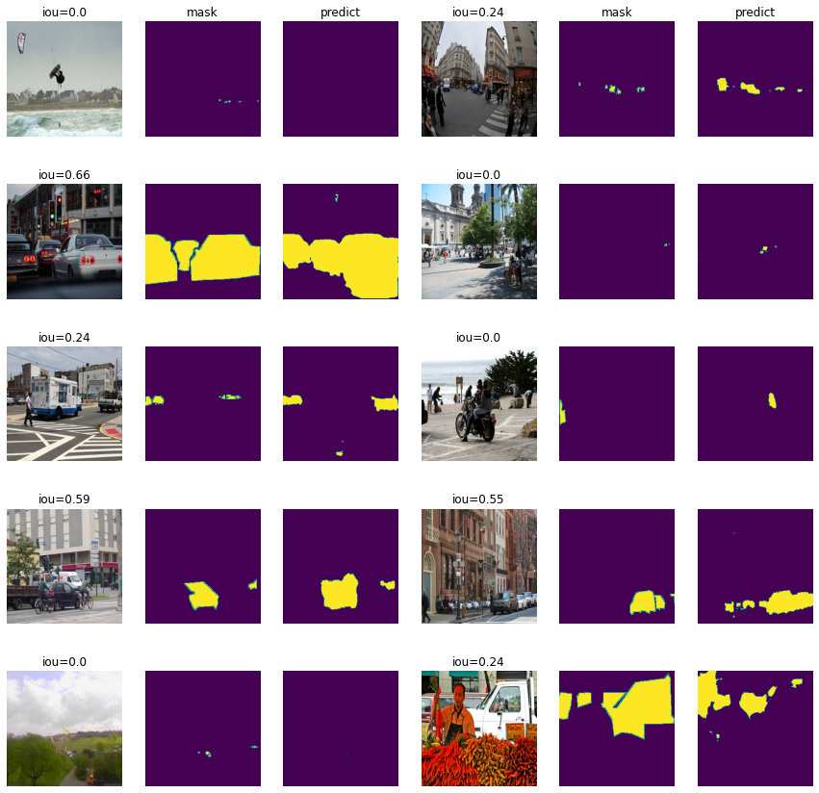

Slide 14
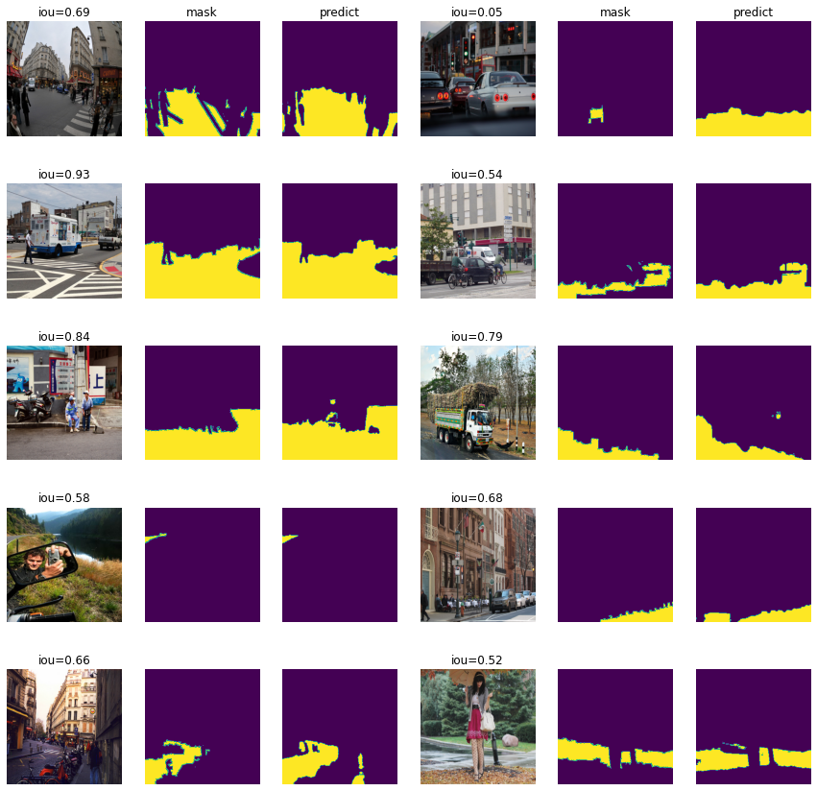

Slide 23
Add error to bounding box
Shift: move whole box i% pixels along x-axis and j% pixels along y-axis; i, j are a random integers from range –k to k where k is a parameter
Resize: wrt bounding box center, adjust box size by p%; p is random integers from range –q to q where q is a parameter
Input is valid IoU
Maybe we can take annotation error into consideration
We could obtain value distribution for k and q from our annotation
Train set size | 8k | 14k | 18k
Origin (k=q=0) | 0.396 | 0.412 | 0.413
k=20, q=10 | 0.399 | 0.414 | 0.410
k=30, q=20 | 0.340 | 0.377 | 0.382
k=30, q=10 | 0.352 |  | 0.391
k=20, q=20 | 0.394 |  | 0.411

